Slide 1
COMP 1017
Flexbox Tricks

Slide 2
So far, we’ve learned two properties for ﬂexbox.

Slide 3
Both of them belong on the ﬂex container.

Slide 4
The ﬂex container is the
direct parent of everything that you want to arrange side-by-side.

Slide 5
The ﬁrst property we learned designates a ﬂex container.

Slide 6
ul.navigation {
display: flex;
}
/* This creates a flex container. */

Slide 7
The second property we learned allows a single ﬂex container to have multiple rows.

Slide 8
ul.navigation { display: flex; flex-wrap: wrap;
}
/* This enables multiple rows. */

Slide 9
Let’s learn a few more.

Slide 10
Centering Things

Slide 11
… but ﬁrst, let’s go over some terminology.

Slide 12
In a ﬂex container, the main axis runs horizontally (left to right).

Slide 13
The cross axis runs vertically (top to bottom).

Slide 14
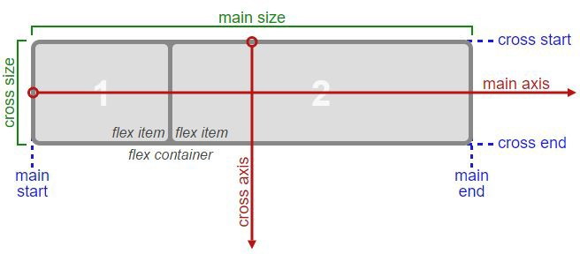

Slide 15
We can centre ﬂex items both vertically and horizontally by changing how they arrange themselves inside a ﬂex container.

Slide 16
main header {
display: flex;
justify-content: center;
align-items: center;
}

Slide 17
justify-content changes how ﬂex items arrange themselves horizontally.

Slide 18
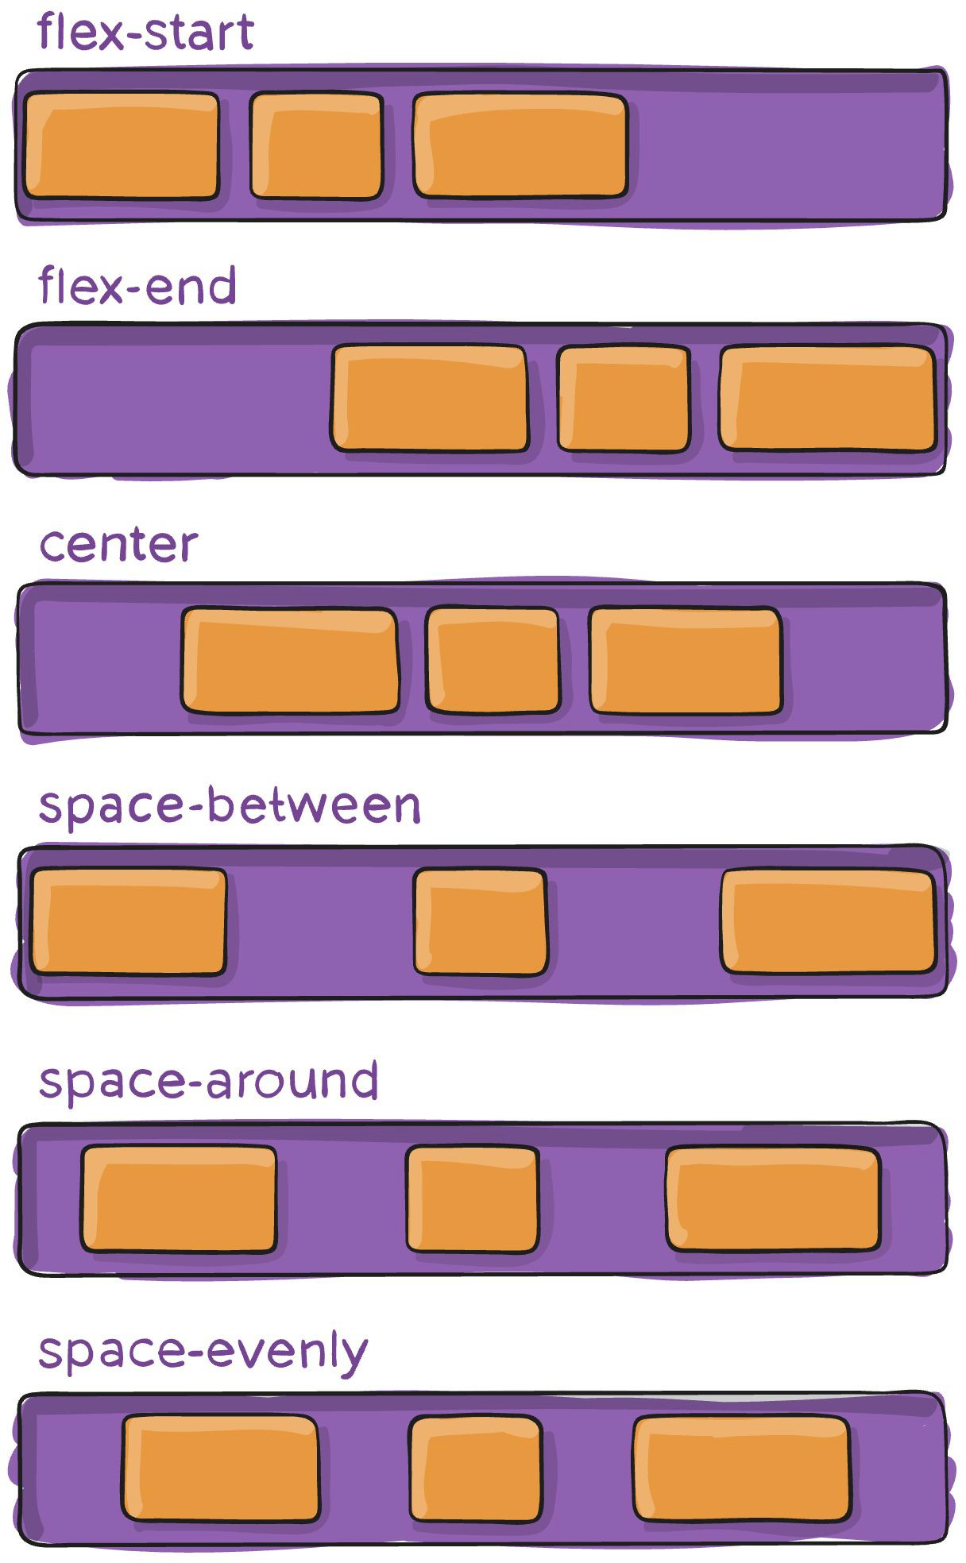

Slide 19
Likewise, align-items changes how ﬂex items arrange themselves vertically.

Slide 20
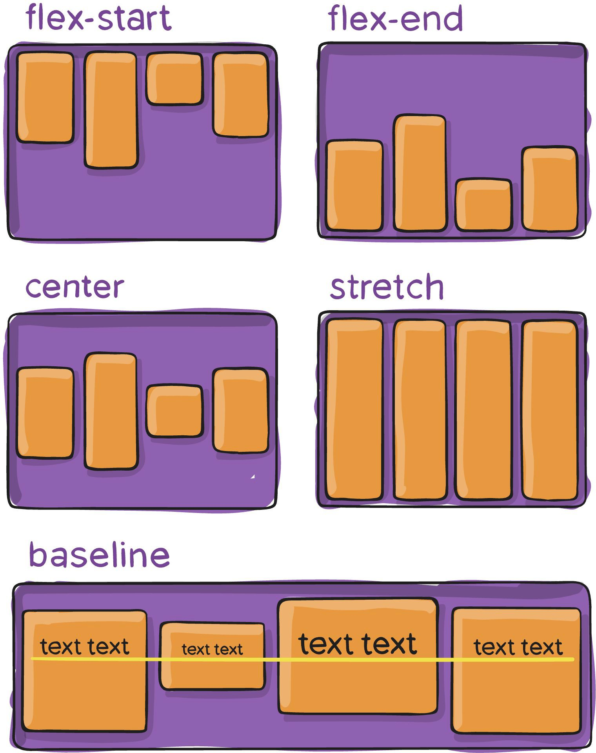

Slide 21
This centering trick could be used for a particular element in Assignment 3…

Slide 22


Slide 23
Flex-Grow

Slide 24
So far, we’ve been using absolute measurements in this course.

Slide 25
This means that, no matter where our website is displayed, all of our elements will always be the same size.

Slide 26
However, there’s a very easy way to use relative units to resize speciﬁc ﬂex items.

Slide 27
flex-grow allows us to decide how much room a ﬂex item can occupy, relative to all of its siblings.

Slide 28
Unlike all of our other ﬂexbox properties so far, flex-grow belongs on the ﬂex item.

Slide 29
ul.navigation li {
flex-grow: 1;
}
/* This says, ‘every list item should take up one portion of space.’ */

Slide 30
Unlike all of our other ﬂexbox properties so far, flex-grow belongs on the ﬂex item.

Slide 31
Further Reading
Centering in CSS: A Complete Guide
https://css-tricks.com/centering-css-complete-guide/
A Complete Guide to Flexbox
https://css-tricks.com/snippets/css/a-guide-to-flexbox/

